Slide 1
Toy Horse Conjoint Analysis
MSMA Group 11
Qianyu Dong | Sichun Li | Xinbei Jin | Congrong Shen | Xiao Shi

Slide 2
Executive Summary
To maximize profit, EarlyRiders should change its product mix as below:
In the short term (1 yr), launch 26" Racing Bouncing $119.99 (profile 4) and 18" Glamorous Rocking $119.99 (profile 14);
In the long term (2-5 yrs), remove profile 14, keep 26" Racing Bouncing $119.99 (profile 4), add 18" Racing Rocking $119.99 (profile 6) and 26" Glamorous Rocking $119.99 (profile 16).
Key Insights
Post-hoc segmentation reveals the 3 major segments in the market:
Bouncing Seeker 40% of market, best target of 26" Racing Bouncing $119.99 (profile 4);
Elegant Rocker 34% of market, best target of 26" Glamorous Rocking $119.99 (profile 16);
Litter Rocker 26% of market, best target of 18" Racing Rocking $119.99 (profile 6).
A priori segmentation shows that profile 16, 4 and 8 are the ideal products for the 4 gender/age-based segments.
Refining EarlyRiders’ product mix could lead to an estimated short term market share of 94.5% with a profit of $199,756 and a long term market share of 94% with a profit of $671,955.
New product line strategy could generate a total 5 yrs profit of $871,711, which is 1.8 times of 5 yrs profit of status quo.

Slide 3
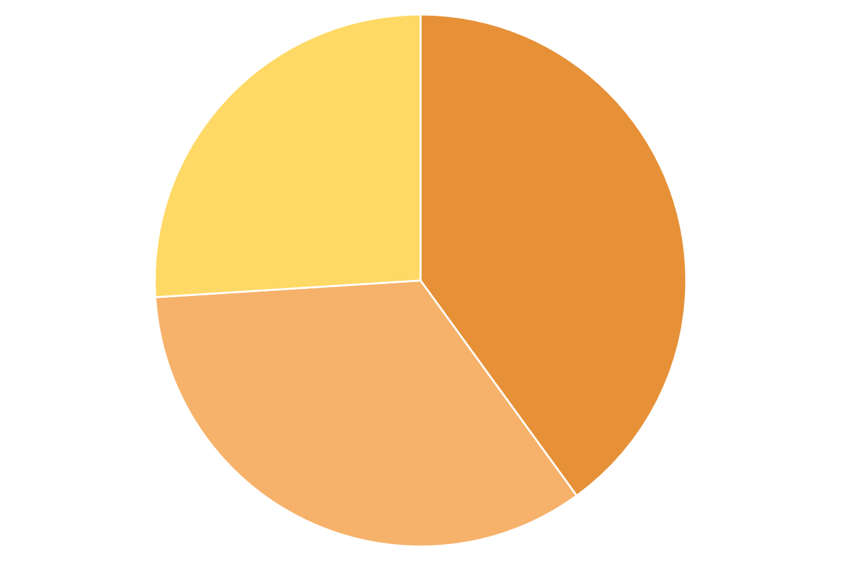
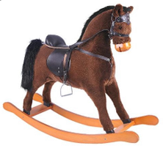
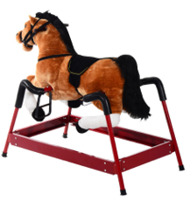
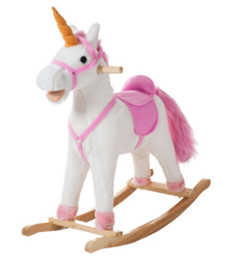
Post-hoc Segmentation
According to post-hoc segmentation, the market can be divided into 3 segments:
Like small model
Prefer rocking motion
Intermediately price-sensitive
Indifferent about style
Prefer large model
Love bouncing motion
Most price-sensitive among the three segments
Prefer racing style
Little Rocker
26%
Bouncing Seeker
40%
=> 18" Racing Rocking $119.99 (profile 6)
=> 26" Racing Bouncing $119.99
(profile 4)
Love large-sized toy horse
Prefer rocking motion
Least price sensitive among the three segments
Especially into glamorous style
Elegant Rocker
34%
=> 26" Glamorous Rocking $119.99
(profile 16)
* More details about calculation are attached in Appendix 1 & 2.

Slide 4
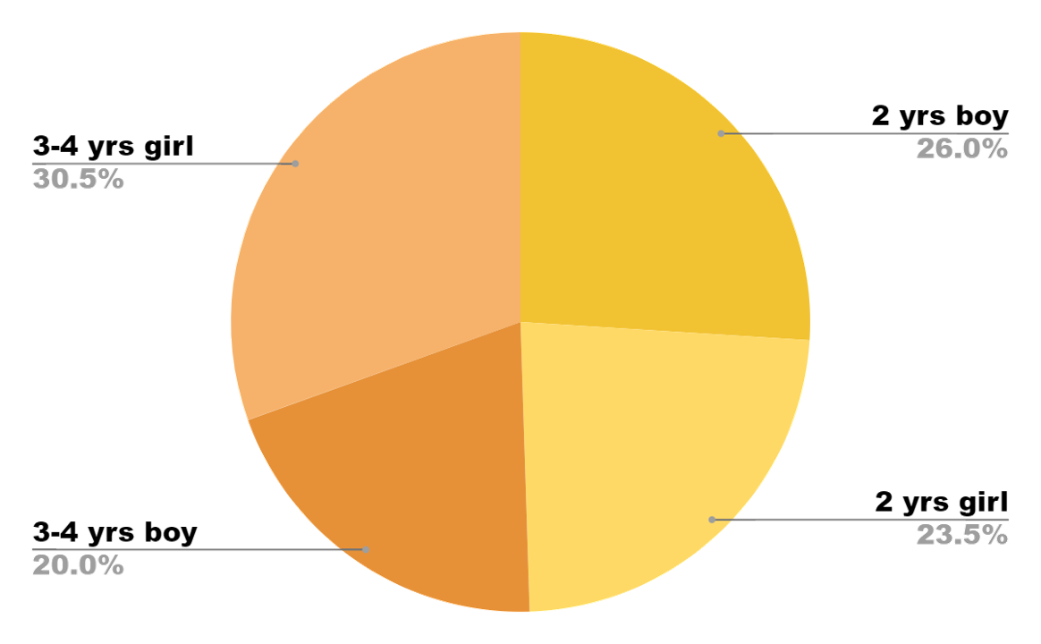
A priori Segmentation
Based on gender and age, we divided consumers into 4 segments.
26" Glamorous Rocking $119.99 (profile 16) could satisfy both 2 yrs and 3-4 yrs girls, covering more than 50% of the market.
26" Racing Bouncing $119.99 (profile 4) meets the need of 3-4 yrs boys, which is yet to be satisfied by the current products in the market.
26" Racing Rocking $119.99 (profile 8) is the ideal product for 2 yrs boys, which could be seen in the market if EarlyRiders’ rival lowers the price of its current product.
However, 18" Racing Rocking $119.99 (profile 6) could also be considered for this segment.
Segment-level attribute preferences
Low price + large size
+ rocking + glamorous
Low price + large size
+ rocking + racing
Low price + large size
+ bouncing + racing
Low price + large size
+ rocking + glamorous
* More details about calculation are attached in Appendix 3.

Slide 5
Market Simulation (Short-term: 1 yr)
We start from calculating first year’s profit. In order to avoid additional cost for switching product line, we target only two segments.
Profile 16 (26" Rocking Glamorous $119.99) performs well in stealing competitor’s market share because all girls like it.
However, targeting the largest two segments is not most profitable due to 26" Rocking’s high variable costs.
The most profitable short-term set is profile 4 and 14, targeting segment 1 (26%) and segment 2(40%). The highest profit is $199,756.
Targeted Segmentations | Scenario | Market Share | First year’s profit
Status-quo: Seg 1 (26%) | 7(C) | 5, 13 | 0.57 | 0.22, 0.21 | $135,863
Segments (26% + 40%) | 7(C) | 4, 14 | 0.055 | 0.52, 0.425 | $199,756
Segments (40% + 34%) | 7(C) | 4, 16 | 0 | 0.405, 0.595 | $186,067
Segments (26% + 34%) | 7(C) | 6, 16 | 0 | 0.5, 0.5 | $189,293
Little Rocker
26%
Bouncing Seeker
40%
Elegant Rocker
34%
Concern: When being stolen market share, what would our competitor do in response?
* More details about calculation are attached in Appendix 4.

Slide 6
Market Simulation (Long-Term: 2-5 yrs)
Competitor’s Reaction: Lower its price, more like Profile 8.
After calculation, we found the profit of covering all 3 segments is larger than only targeting 2 segments regarding to competitor’s reaction, so we list 2 scenarios for 3 segments below:
As A priori segmentation shows, preferences of kids vary most upon motion and style, so compared with Profile 14, we would recommend to launch Profile 6.
Scenario | Market Share | 2nd year’s profit | 3-5 years’ profit
8(C) | 4, 14, 16 | 0.085 | 0.355, 0.22, 0.34 | $158,677 | $496,029(165,343*3)
8(C) | 4, 6, 16 | 0.06 | 0.355, 0.235, 0.35 | $157,989 | $513,966(171,322*3)
* More details about calculation are attached in Appendix 4.
* Since most of toy horses’ sold around holidays, we assumed competitors will react to our price one year later.
* As to long-term profit, we need to calculate switching fixed cost in 2nd year, but don’t need to consider it afterwards because product types don’t change.

Slide 7
Market Simulation (Best Launch Plan)
Short Term (1st Yr) Long Term (2-5 Yrs)
Profile 7
26" Rocking Racing ($139.99)
Profile 8
26" Rocking Racing ($119.99)
Competitor
EarlyRiders
Profile 4
26" Bouncing Racing ($119.99)
Profile 6
18" Rocking Racing ($119.99)
Profile 16
26" Rocking Glamorous ($119.99)
Profile 4
26" Bouncing Racing ($119.99)
Profile 14
18" Rocking Glamorous ($119.99)
Highest Profit for 5 years = $871,711
1.8 times of 5 years’ profit for status quo ($479,315)
* More details about calculation are attached in Appendix 4.

Slide 8
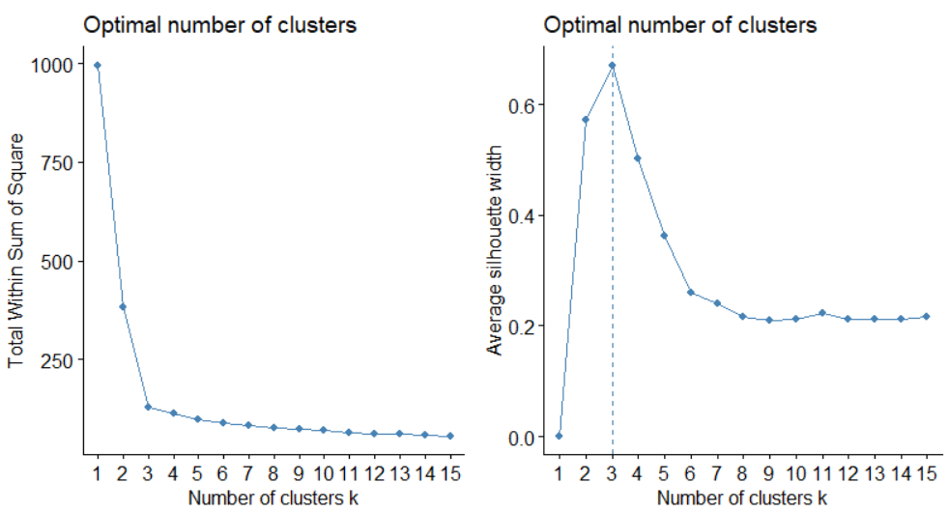
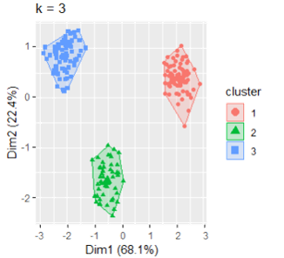
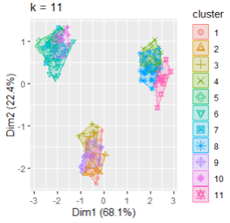
Appendix 1: Post-hoc Segmentation
Determining number of clusters
Strong elbow pattern shows that three is the appropriate number of segments;
Focal points are at 3 and 11. 11 might be too many for 200 observations.
k = 3 gives the best clustering results;
k = 11 leads to a lot of overlap and low sample size in each segments.

Slide 9
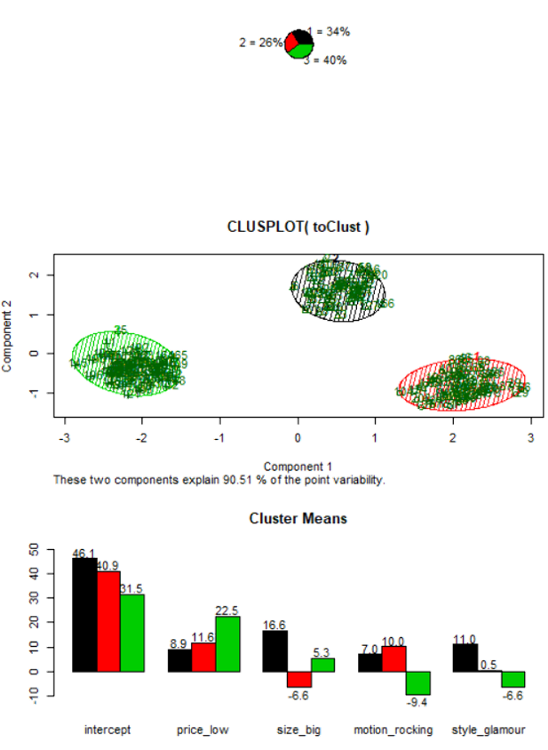
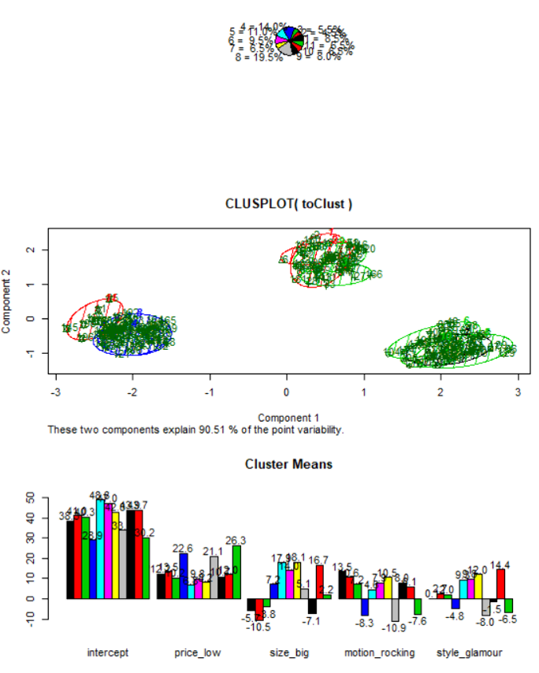
Appendix 2: Post-hoc Segmentation
Segmentation when k = 3 & k = 11

Slide 10
Appendix 3: A priori Segmentation
Segment-level coefficient
Segment-level preference and ideal profile
Segment | Size | Preference | Ideal Profile
2 yrs Boy | 832(26%) | Low price+large size+rocking+racing | 8, (6)
2 yrs Girl | 752(23.5%) | Low price+large size+rocking+glamorous | 16
3-4 yrs Boy | 640(20%) | Low price+large size+bouncing+racing | 4
3-4 yrs Girl | 976(30.5%) | Low price+large size+rocking+glamorous | 16
* Profile 6 can also be considered by 2 yrs boy, since coefficient of size_big is smallest compared with other segments.

Slide 11
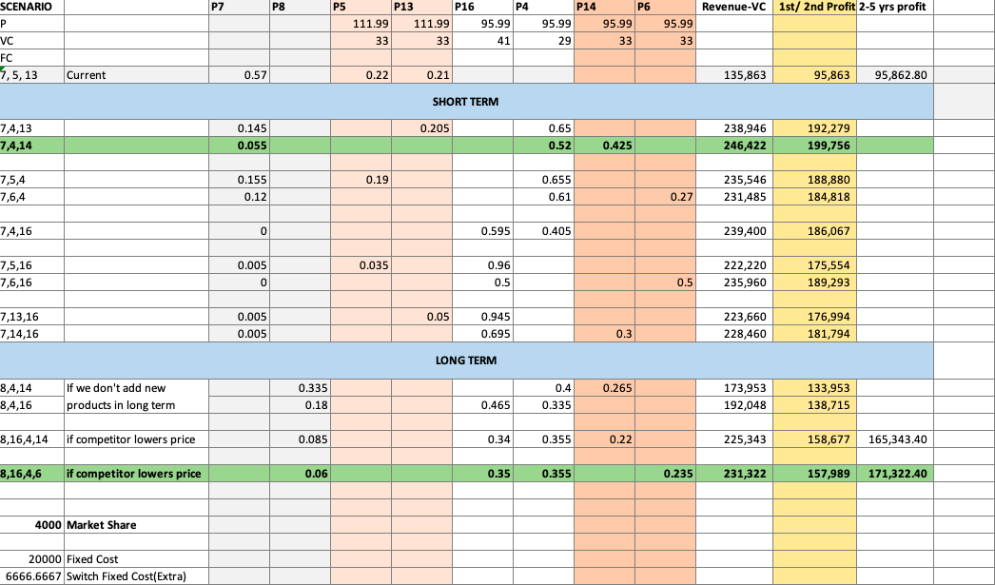
Appendix 4: Market Simulation

